Slide 1
Mojaloop Core, Releases & PQS
Mojaloop Open Source community event #26 Kigali, Rwanda
Sam Kummary, MLF

Slide 2
Agenda
Mojaloop end-of-PI25 Overview - Core & Releases, PQS
Mojaloop Releases
Mojaloop Platform and Quality
Release Roadmap

Slide 3
Mojaloop
PI-25 UPDATE
Separation of external dependencies, Bulk SDK support,
FX,
Inter-scheme
PQS Updates,
Performance improvements, Release automation,
IaC upgrades (v5.4.x+)
Bulk payments enhancements
Node upgrade to v18,
Performance
PI-19
PIs 20/21
PI-22
PI-25
15.1.0
16.0.0
Congo
14.1.1
14.1.0
15.0.0
15.2.0
Acacia
17.0.0*
Irrawaddy
PI-20
PI-21
PI-23
PR reviews, then RC
ML TTK enhancements,
Rules UI enhancements
SDK Support for RTP, DevOps; Move to EKS,
IaC v4.1.0
Performance improvements :Batching, logging. Release automation. IaC v5.0.0
* Version numbers guided by SemVer

Slide 4
Mojaloop Platform
API Gateway, Outer security layers
Finance Portal, monitoring, operational support
Supporting services, connectors
Core
Mojaloop Core
Transactional hub components and settlement i.e. API layer, central ledger (including bulk), settlement, ALS, quoting, trx req
3PPI, ml-connectors
Best practice Mojaloop connectors. I.e. Third-party services, sdk adapter/ml-connectors
Supporting services
Interop: Connect with settlement banks, Onboarding FSPs, integrations (connection management)
Mojaloop Toolkit (TTK), ITK instances, Simulators, ALS support, CEP, Events processing
Oracles - MSISDN or Merchant Registries
Finance portal (RBAC), Reporting
Hub operator UI & API experience layer that is Implemented by business operations framework.
Monitoring support (Operational support)
Operational support & tracing (e.g. EFK / Prometheus, Grafana, Loki, etc) [IaC: Grafana, Prometheus & Loki]
API Gateway
IP filtering, Ingress/Egress, Firewalls, Security support (JWS, mTLS) [IaC provides this via Istio (older versions used WSO2)]
Adds in the rules and enforces the Mojaloop Security design
Infrastructure
Kubernetes, Infrastructure as Code, Automated deployments (IaC, Rancher)
Deployment artifacts - Helm Charts, Docker Containers, npm packages

Slide 5
Mojaloop Congo - v16.0.0
Core - Mojaloop Release (Helm Release 16.0.0)
Base use-cases: P2P, R2P, Bulk, PISP
Settlement: Deferred-net, Continuous Gross
Admin: (Participant Lifecycle API)
Bundled Mojaloop IaC Release (Mojaloop IaC Release 5.0.0)
Gateway & Load Balancers
RBAC via Istio and Ory Stack
Mojaloop Security (mTLS, JWS, ILP)
Finance Portal
Reporting
Control Plane for CI/CD (GitLab)
Technical Operational Dashboards
Participant Onboarding Support (Connection Manager)
Mojaloop Release announcement on community central

Slide 6
Mojaloop Irrawaddy - v17.0.0*
Core - Mojaloop Release (PRs in review)
Base use-cases: P2P, R2P, Bulk, PISP, FX, Inter-scheme
Settlement: Deferred-net, Continuous Gross, FX support
Admin: (Participant Lifecycle API)
Bundled Mojaloop IaC Release (Mojaloop IaC Release 5.4.0+)
Gateway & Load Balancers
RBAC via Istio and Ory Stack
Mojaloop Security (mTLS, JWS, ILP)
Finance Portal – support for FX and inter-scheme
Reporting
Control Plane for CI/CD (GitLab) – CC v2
Technical Operational Dashboards
Participant Onboarding Support (Connection Manager)
*Designs and PRs presented at DA. PRs in final stages of review. Snapshot testing successful

Slide 7
Workstream Objectives PI-25
Maintain Mojaloop Congo - v16.0.0 and improve stability along with IaC v5.0.0
Continue working on releases - Mojaloop v16.1.0 / v17.0.0
Deliverables by workstreams – FX , Inter-sceme to be included when ready
Enhancements done under perf-workstream to be included with Mojaloop releases
Merchant use case related services to be included
Security patches to be included
Maintain Mojaloop's QA/Dev environments for bug fixes and other changes
Support existing implementers by fixing bugs and performing other maintenance related tasks
Release for FX / Inter-scheme features in consultation with prod-council
Workstream progress can be tracked on Mojaloop project repo

Slide 8
Ongoing activities end-of-PI-25
RC testing for v17.0.0 in progress; Testing with snapshot releases completed successfully, demonstrated
A patch release Mojaloop v16.0.4 made
Testing sandbox capabilities, troubleshooting issues
Supporting deployment scenarios for adopters, work-streams
Testing of Finance Portal deployment on Mojaloop Dev/QA environments
Facilitate Mojaloop deployment enhancements, documentation updates and related testing
Workstream progress can be tracked on Mojaloop project repo

Slide 9
Status for end-of-PI25
Current ML v17.0.0 RC
Deliverables from FX, Inter-scheme workstreams to be included. PRs in final reviews
Performance enhancements by community, performance workstream
Merchant payment workstream (includes merchant registration portal)
Security patches, upgrades to dependencies, services
Sample PR link for reference: https://github.com/mojaloop/helm/pull/640 (to be updated)
Roadmap
IaC release supporting Mojaloop v17.0.0
Next Mojaloop release (likely v18.0.0)
to support ISO 20022 messaging
Platform quality & security related updates
General maintenance, bug fixes, release testing
Community & Adopter support
Support community contributions and absorption into Mojaloop as required
Documentation updates
Supporting deployment activities and troubleshooting
Notes:
Components:
- [x] core libraries
- [x] ml-number
- [x] api-snippets
- [x] central-services-db (database-lib)
- [x] central-services-stream
- [x] central-services-logger
- [x] central-services-metrics
- [x] central-services-health
- [x] central-services-shared
- [x] central-services-error-handling
- [x] sdk-standard-components
- [x] event-sdk
- [x] object-store-lib
- [x] central-ledger
- [x] ml-api-adapter
- [x] quoting-service
- [x] central-setttlement
- [x] account-lookup-service
- [x] bulk-api-adapter
- [x] event-sidecar
- [x] transactions-requests-service
- [x] Third-party (3PPI)
- [ ] ALS consent oracle
- [x] Thirdparty-API-Svc
- [ ] Thirdparty-SDK
- [ ] auth-service
- [ ] TTK
- [ ] ttk toolkit
- [ ] ttk toolkit ui
- [ ] ttk shared lib
- [ ] ttk client lib
- [ ] mojaloop-simulator
- [ ] simulator (legacy, ALS oracle)
- [ ] ALS oracle pathfinder
- [ ] Oracle shared library (not high priority - not required for v14 release)
- [ ] ALS oracle template (not high priority - not required for v14 release)
- [ ] central-event-processor
- [ ] event-stream-processor
- [ ] email-notifier
- [x] sdk-scheme-adapter ([sdk-scheme-adapter/pull/452](https://github.com/mojaloop/sdk-scheme-adapter/pull/452))

Slide 10
Mojaloop Switch Functionality – FSPIOP Use Cases (PI-25)
Mojaloop FSPIOP API v1.1, v2.0 Use cases
Payer-Initiated Transaction
[●] P2P Transfers
[●] Customer-Initiated Merchant Payment
[●] Customer-Initiated Cash-out - Receive Amount
[●] Customer-Initiated Cash-out - Send Amount
[●] ATM-Initiated Cash-out
[●] Refund
[●] Foreign Exchange and Inter-scheme
Bulk Transactions
[●] Bulk Payments
Payee-Initiated Transaction
[●] Merchant-Initiated Merchant Payment
[●] Agent-Initiated Cash-out
[●] Agent-Initiated Cash-In – Send Amount
[●] Agent-Initiated Cash-In – Receive Amount
Payee-Initiated Transaction using OTP
[●] Merchant-Initiated Merchant Payment Authorized on POS
[●] Agent-Initiated Cash-out Authorized on POS
Key
[●] Supported with functional tests
[●] Supported
[●] Proof of Concept
[●] Not implemented
[○] Out of Scope

Slide 11
Switch Functionality: Mojaloop End-points (PI-25)
FSPIOP API v1.1, v2.0 Specification
Transfers*
[●] POST - Prepare
[●] PUT - Response
[●] PUT – Error
[●] PATCH – Notification
[●] GET - Query
Parties
[●] GET - Request
[●] PUT - Response
[●] PUT - Error
Quotes
[●] POST - Request
[●] PUT - Response
[●] PUT - Error
[●] GET - Query
Participants
[●] POST - Create
[●] PUT - Response
[●] POST - Bulk Create
[●] PUT - Error
[○] DEL - Delete
Transactions
[○] PUT - Response
[○] GET - Query
TransactionRequests
[●] POST - Request
[●] PUT - Response
[●] PUT - Error
[●] GET - Query
Authorizations
[●] GET - Request
[●] PUT - Response
[●] PUT - Error
BulkTransfers*
[●] POST - Request
[●] PUT - Response
[●] PUT - Error
[●] GET - Query
BulkQuotes
[●] POST - Request
[●] PUT - Response
[●] PUT - Error
[●] GET - Query
fxQuotes*
[●] POST - Create
[●] PUT - Response
[●] GET - Query
[●] PUT - Error
fxTransfers*
[●] POST - Request
[●] PUT - Response
[●] PUT - Error
[●] GET - Query
Key
[●] Supported with functional tests
[●] Supported
[●] Proof of Concept
[●] Not implemented
[○] Out of Scope
*Enhancements in PI-25

Slide 12
Switch Functionality – Administration (PI-25)
Admin API v1.0 Specification
ALS Oracle API v1.0 Specification
Participants
[●] Manage Participants
[●] Create Initial Values
[●] Query
[●] Update
[●] Manage positions, limits
[●] Create Initial Value
[●] Query
[●] Update
[●] Manage Callback URLs
[●] Create Initial Value
[●] Query
[●] Update
Settlement Models
[●] Settlement models
[●] Configure
[●] Query
Oracles (ALS)
[●] Manage Oracles
[●] Create
[●] Query
[●] Update
[●] Delete
Participant Accounts
[●] Manage accounts
[●] Create
[●] Query
[●] Update
[●] Funds In/Out
Services
[●] Services FXP*
[●] Get (Query)
[●] PUT
Transactions
[●] Transactions
[●] Query
Key
[●] Supported with functional tests
[●] Supported
[●] Proof of Concept
[●] Not implemented
[○] Out of Scope
* Enhancements in PI-25

Slide 13
Switch Functionality – Settlement (PI-25)
Settlement API v2.0 Specification
Settlements v1.0 [Deferred, Multilateral Net]
[●] Open, close Settlement Windows
[●] Query Settlement Windows
[●] Query Settlement Report
[●] Create/Trigger Settlement with Windows
[●] Process successful Settlement Acknowledgements
[●] Reconcile Positions based on successful Settlements
[●] Process failed Settlement Acknowledgements
Settlements v2
[●] Settlement models
[●] Designs
[●] Settlement by Currency
[●] Interchange Fees
[●] Continuous Gross Settlement
Key
[●] Supported with functional tests
[●] Supported
[●] Proof of Concept
[●] Not implemented
[○] Out of Scope

Slide 14
Switch – Third-party (3p) API v1.0 (PI-25)
Third-party API v1.0 Specification
Linking
[●] Pre-Linking
[●] Discovery
[●] Request consent
[●] Authentication
[●] Grant consent
[●] Credential registration
Un-Linking
[●] Un-linking
Third-party (3p) Transfers
[●] Discovery
[●] Agreement
[●] 3p transaction request
[●] 3p authorization
[●] Signed authorization
[●] Validate authorization
[●] 3p Transfer
[●] Query trxreq status
Key
[●] Supported with functional tests
[●] Supported
[●] Proof of Concept
[●] Not implemented
[○] Out of Scope

Slide 15


Mojaloop Release Process - overview
Feature
Refining
Implementation
Eg: v17.0.0* Release Candidate (RC)
QA
A feature or high level topic is identified during Program Increment(PI) planning
Stories are refined and Acceptance Criteria finalized
Design, Development, PR, Merging to master, CI process, Testing
QA is performed on a deployment with the RC using various test collections.. Bugs are logged for issues found & triaged, fixed
PI Planning
Sprint/Release/Schedule
Setup/helm
Priority issues, bugs
RC
Deploy
Announcements
PI/Sprint
Bug Fixes, Hot Fixes
Sprint
Bug Fixes, HotFixes, Priority Features added mid-pi
Individual services released, deployed
Epics, Stories
Release to Community
Epics and Stories based on features are accepted at PI/Sprint level.
List items for the Release Candidate - Features, fixes, maintenance
A release for a repo/service/library is made on GitHub & package/image pushed to npmjs or dockerhub. It is then deployed on Dev environment (on AWS). This happens multiple times.
Sprint Planning
If there are no high-priority bugs, and all criteria for a public release are met, this is released to Community and announcements made with detailed release notes.
* SemVer x.y.z. Moved to pure Semver starting PI-11 (11.x.x)
Stories are prioritized and added to specific Sprint Milestones
Note: This depicts a single iteration that may happen multiple times
Notes:
[Sam] Adding this slide here on request from the ML Foundation
Focus on the process: SAFe and how contributors can join or are part of the process (with workstreams)

Slide 16
ML Releases: PI-24/25 update for reference
Acacia
Congo
v15.0.0
(PI-20/21)
v15.1.0 (PI-21)
v15.2.0
(PI-22/23)
v16.0.0 (PI-23)
Separations of external backend dependencies from Mojaloop Helm charts
Utilise externalised secrets for password management (#3082)
Bulk SDK functionality support out-of-the box
IaC v4.0.x with support for Mojaloop v15.0.0 & passwords with Special Characters managed by HashiCorp-Vault
Finance Portal v3 (BoF v3.0.0) fixes for passwords with Special Characters
Test against upgraded QA/Dev with K8s v1.26/1.27
Refactored QA/Dev env ease of maintenance with EKS
Enhanced SDK support for Request-to-Pay (R2P)
Follow-up bug-fixes
IaC v4.1.0 with support for Mojaloop v15.1.0
Upgraded QA/Dev env & Tested against K8s v1.28
General maintenance
Node upgrade (v18 LTS)
Performance setup, profiling and document bottlenecks (perf workstream)
Performance Stream improvements (enhancements, fixes, instrumentation, & contribs)
Automated, CI tests on ML releases with Helm snapshot support
General maintenance
Node upgrade for supporting services not updated in v15.2.0
Performance enhancements done by perf-workstream included
Automated CI steps on Mojaloop releases
IaC changes - new and refactored version

Slide 17
Release Roadmap: MLF Product, Community and work-stream
Congo
v16.0.0 PI-23
v17.0.0 Irrawaddy (PI-25, RC testing)
Future
v18.0.0 / vX.Y.Z
Performance enhancements done by perf-workstream included
IaC changes - new and refactored version
Automated CI steps on Mojaloop releases (not included in the release but used in the process)
General maintenance
Node upgrade for supporting services
Deliverables from FX workstream
Inter-scheme updates
Merchant payments features
PQS updates - security patches and upgrades
Include enhancements, updates from Performance workstream
General maintenance
Support for ISO 20022 messaging
Settlements improvements
PISP Bulk API support (#109)
Enhance tracing components to use latest open-tracing standards
Automated CI testing on Helm PRs & Releases - completed
Migrate Chart (i.e. BoF) to Helm repo, and clearly rename Finance Portal components part of BoF
Patch notification support for failures

Slide 18
Mojaloop Platform Quality & Security (PQS) PI26

Slide 19
SBOMs for Mojaloop repositories
Goals
Generate and document SBOMs for each repository/service.
Automate periodic publication of metrics and SBOMs.
Flag anomalies and discrepancies in SBOMs.
Maintain a list of open security alerts for core platform repositories.
Aggregated view at Mojaloop level along with individual analysis
What is an SBOM?
A Software Bill of Materials (SBOM) is a machine and human-readable list of a project's entire software inventory.
Why do organizations need an SBOM?
Transparency
Security
Compliance
Maintenance
What all does SBOM contain?
Open-source components
Third-party components
Licenses
Versions of components
Patch status of components
Open-source vulnerabilities
Package names
Package versions
CycloneDX Generator
It is the official OWASP SBOM tool
Supports many languages-C, C++, JavaScript, Java, Python
Comes with a CLI that can scan locally or as part of a CI/CD pipeline and an API server
Output format is CycloneDX
Links
https://github.com/mojaloop/community-tools/tree/master/oss-stats/sbom
https://www.npmjs.com/package/%40cyclonedx/cyclonedx-npm
https://github.com/mojaloop/ml-api-adapter/pull/530

Slide 20
Mojaloop PQS: Mojaloop releases
Review core and related repositories released with Mojaloop for
Snyk alerts for Central-ledger repository are addressed
Dependabot alerts for Central-ledger repository are addressed (moderate, high and critical)
Ensure main branch is protected and collaborator list is up-to-date
Ensure open PRs are addressed, closing stale PRs
Update audit exceptions json file to remove exceptions added that are not necessary anymore
Close issues on the repository that are fixed / out-of-date
Ensure codeowners file is current
SBOMs for all repositories published with a Mojaloop release - PI25
Address deprecated dependencies - PI25
Reviewing updates and vulnerabilities (GitHub, NVD, other related media) constantly
Take necessary action for Mojaloop services as required
Provide guidance and mitigate exposure to Mojaloop following the Mojaloop CVD and Cybersecurity policies

Slide 21
Mojaloop PQS: PI-25 updates
SBOM for component and Mojaloop platform
Hardening of Mojaloop releases - continuation
SonarCloud - followup issues
GitHub repository maintenance
Blog posts and guidance to implementers and improve documentation - in progress
Improve tooling used in CI/CD - ci tools, license checkers - next PI
OpenSSF checklist and compliance - next PI
Stress / Load testing of Mojaloop - next PI
PQS Workstream Mojaloop slack channel: https://mojaloop.slack.com/archives/C06UW0E2KBN

Slide 22

Mojaloop PQS: Objectives
Hardening of Mojaloop releases
Security testing of Mojaloop
Assess feedback from testing done by security experts, internally
Prioritize issues based on criticality and severity
Update backlog with stories to address issues
Review core and related repositories released with Mojaloop for
Ensure dependabot alerts are addressed
Ensure Snyk issues are addressed
Review any tasks “to-do” in the codebase and related quality issues
Review PRs in critical repositories and address (close, approve / reject)
Update nodejs version for any services not yet upgraded
Update maintenance tooling (license-scanner and such)
GitHub maintenance of Mojaloop repositories (used in the platform) (continuation)
Hardening Mojaloop core and addressing any known and reported quality, security issues
SBOM of dependencies in Mojaloop to better manage situations
Provenance of Mojaloop artefacts - PI26 candidate

Slide 23
Mojaloop PQS: Design & Implementation guidance
Mojaloop Invariants: https://docs.mojaloop.io/community/standards/invariants.html
Mojaloop CVD policy: https://docs.mojaloop.io/community/contributing/cvd.html#disclosing-and-receiving-information-regarding-security-vulnerabilities
Mojaloop cyber-security architecture: https://docs.mojaloop.io/community/tools/cybersecurity.html#mojaloop-cybersecurity-architecture
Guidance around moving from alpha / beta to release quality: https://community.mojaloop.io/mojaloop_foundation/pi-22-core-releases-work-stream-reviews-4ami
Other Mojaloop standards: https://docs.mojaloop.io/community/standards/guide.html#standards

Slide 24
Mojaloop PQS: Roadmap
Hardening of Mojaloop releases - continuation
SonarCloud – analyze issues in detail
Improve tooling used in CI/CD - ci tools, license checkers
OpenSSF badge
Blog posts and guidance to implementers and improve documentation
Provenance of Mojaloop artefacts
Quality issues & maintenance (license file updates)
SBOM analysis in CI steps
Workstream progress can be tracked on Mojaloop project repo

Slide 25
Thank you!
Appendix following this
Resources:
Mojaloop docs: https://docs.mojaloop.io
Mojaloop training program: https://learn.mojaloop.io/

Slide 26
How we work
Messaging: Short-term - Slack; Community central - announcements
GitHub: Issues for longer form discussion; Issue tracking, Project
Documentation
Markdown on GitHub for specifications and documents with long life.
Sequence diagrams: Plant UML, DrawIO, etc…
Our Git process (forking/branching WF), the CLA
Quality gateways
Apache 2.0 License for code
API specifications: docs.mojaloop.io/api , Change requests, Solution Proposals
Scaled Agile Framework (SAFe)
Core & releases Mojaloop slack channel: https://mojaloop.slack.com/archives/C06VB2FHUER

Slide 27
Mojaloop
PHASES 1-2
2016
2016
2017
2018
2018
2018
JUNE
OCTOBER
OCTOBER
FEBRUARY
APRIL
SEPTEMBER
LevelOne Development project kickoff
API Specification project kick-off (PDP)
Mojaloop (branding) and OSS launch at SIBOS
Mojaloop API (FSPIOP) specification launch
First Mojaloop community event in Johannesburg
First Mojaloop official release v3.5.1 (pre-releases so far)

Slide 28
Mojaloop
PHASES 3-6
5.2.0
10.1.0
10.4.0
11.0.0
12.0.0
13.1.0
14.0.0
Sample release from February 2019 https://github.com/mojaloop/helm/releases/tag/v5.2.0
Settlements enhancements
FSPIOP v1.1 support for Mojaloop platform: https://github.com/mojaloop/helm/releases/tag/v10.4.0
Semantic versioning standard adopted: https://github.com/mojaloop/helm/releases/tag/v11.0.0
CGS, Interchange Fee supported: https://github.com/mojaloop/helm/releases/tag/v12.0.0
Patch notifications, ALS, bulk fixes, enhancements, Testing enhancements
Upgrade to node 16. Maintenance: Security, third-party, TTK, sdk updates
2019
2020
2021
2022
Feb
July
Feb
Sep
2020
2021
2022
May
Jan
Mar

Slide 29
Mojaloop
PI-23 UPDATE
Separation of external dependencies, Bulk SDK support,
Bulk payments enhancements
Node upgrade to v18,
Performance
Future deliverables, guided by roadmap, contributions
PI-19
PIs 20/21
PI-22
PI-24
14.1.1
15.1.0
16.0.0
Congo
14.1.0
15.0.0
15.2.0
Acacia
17.0.0*
PI-20
PI-21
PI-23
ML TTK enhancements,
Rules UI enhancements
SDK Support for RTP, DevOps; Move to EKS,
IaC v4.1.0
Performance improvements in Batching, logging. Release automation. IaC upgrades
* Version numbers guided by SemVer

Slide 30

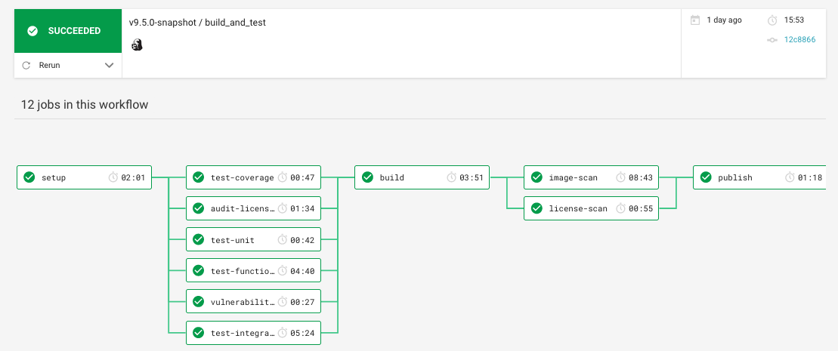

Deployment Architecture: CI/CD Pipeline -
Ref https://app.circleci.com/projects/project-dashboard/github/mojaloop
Build & Publish Artifact
Docker or NPM build and publish to repository
Triggers: Tags
Deploy Artifact
Execute either helm install or upgrade (if existing deployment) with latest Artifacts
Triggers: Tags
Coverage Check
Executes Code Coverage checks. The results will be published to SonarQube if the branch is “Master”.
(npm run test:coverage)
Triggers: PRs, Tags
Audit License Scan
Check NPM dependencies for License Issues
Triggers: PRs, Tags
Image Scan
Check Docker Image for Security Vulnerabilities
Triggers: Tags
Setup
Setup initial OS and NPM dependency cache for tests, builds, and deployments.
Triggers: PRs, Tags
Unit Tests
(npm run test:unit)
Triggers: PRs, Tags
License Scan
Check Docker Image for License Issues
Triggers: Tags
Execute Functional Tests
(npm run test:functional)
Triggers: PRs, Tags
Vulnerability Scan
Check NPM dependencies for Security Vulnerabilities
Triggers: PRs, Tags
Execute Integration Tests
(npm run test:integration)
Triggers: PRs, Tags
Triggers:
➽ Pull-Requests (inc. from external Forks)
➽ Publishing tagged Releases
➽ Publishing tagged Snapshots
Notes:
Here's an example of the CI/CD pipeline that the open source team uses and is available to all. We have a setup step which does the initial build and installation of all dependencies that are needed for a certain component. Next we have a slew of tests that are executed for validations. We have test coverage, audit license checks to make sure that audit licenses are adhering to an approved list. We have the unit tests, functional tests and vulnerabilities to make sure that any dependencies we are using don't have any security issues. Finally, we have integration tests that are executed. Not all the components have all these validations, but majority of them do. All components have audit licensing, unit tests and unit-integration test coverage, etc. Not all components have integration tests, but most of the core components do.
Next we have a build step which builds the artifacts themselves. For example, if it's a micro service, it will build the docker image and perform image scans and license scans to make sure that that those artifact pass the security checks and license checks. If it's a library, it will build in NPM library.
Once everything is built and checks are passed, they are published to their defined repository. So if it's a docker image it will be posted to docker hub, perhaps if it's a library, it will be published to an NPM org.
Not all the CircleCI steps run with every event when code is checked in. In the diagram the dashed line boxes define what is triggered for each event type. The dashed red box encloses all the steps that are executed during pull requests.
A pull request event occurs when someone in the community has made a change to the code and would like that change applied to the master codebase. The change could be an additional feature, functionality or a bug fix. The pull request is the mechanism used to make a request to the open source community to express a want to make some change, and ask that someone review it. A pull-request is opened on GitHub, which is a way for the community to be able to review the code changes suggested. Pull requests are sometimes discussed and additional changes made before they are accepted and applied. In essence, a pull-request provides the mechanisms to approve and accept that code. Attached to the pull request are the test and validation results that are run as part of a pull request. It is not possible to accept a pull request if not all of these validations have run and checks passed.
The other dashed purple box encloses what is run when tagged releases and snapshots are published. At some point code has been changed and a new release is required. New releases are required before the changes can be run and the artifacts used. To do that, they we would create a tagged release or maybe a snapshot if we want a daily build that we want to run some tests on. And that would basically kick off the remainder of the process to be able to do the building of the artifacts, the image scanning, the license scanning and then the publishing to the artifact repository like Docker hub, etc..

Slide 31
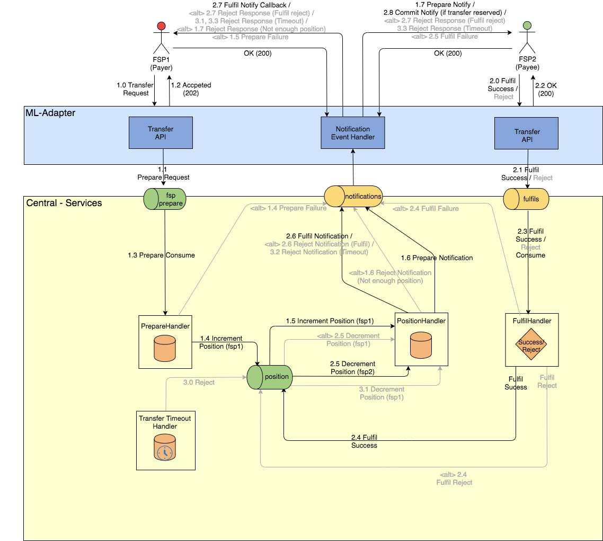
Mojaloop Transfers Architecture v1.1
Notes:
Link to API deck:
https://docs.google.com/presentation/d/1Jw78zxcTkSSFgQvmYChDiQcUfEZQHFZm/edit#slide=id.p2

Slide 32
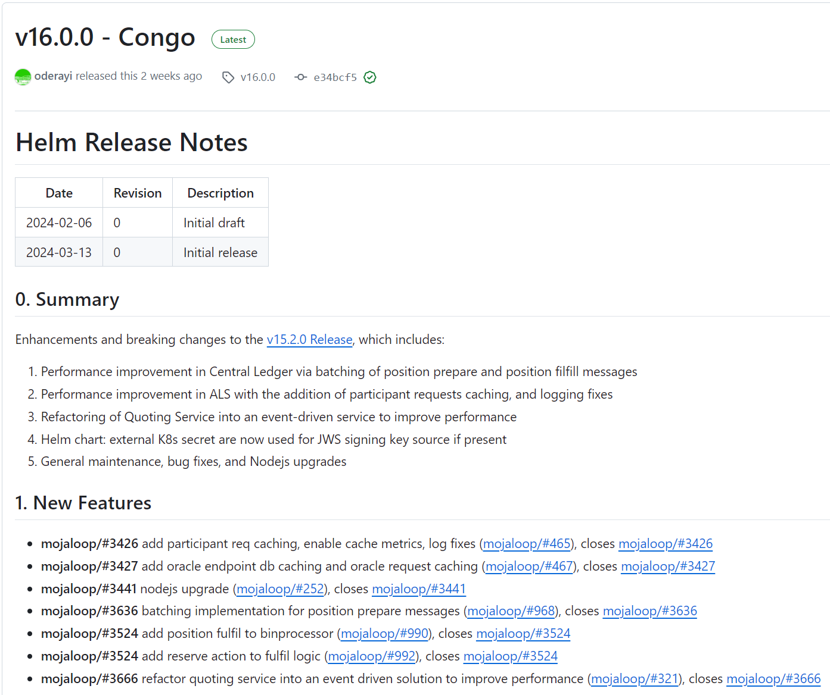
Release Automation: validation, usage
Automated Update of Helm Chart Packages with updatecli
Detection of Breaking Changes - DB Migrations, Default Configuration Changes
Generation of Changelog
Determination of Next Release Version Number
Generation of Release Note
Deployment of RC to OSS Test Environment
Release Candidate Validation with TTK
Creation of Release Candidate Pull Request
Bug Fixes, PR Reviews, Github Release
The automation scripts can be found here:
https://github.com/mojaloop/helm/tree/main/.github/workflows

